Slide 1
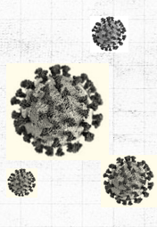
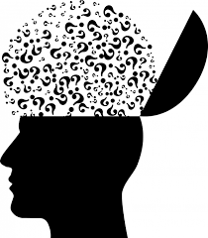
Computational Analysis of Mental Health Disorders during COVID-19
Arooj Fatima 2019-CS-102
Vaniza Riaz 2019-CS-105
Rimsha Zaib 2019-CS-113
Project ID 26

Slide 2

Project Title:
Computational Analysis of Mental Health during COVID-19
Problem Statement:
Computational Analysis and Prediction of Mental Health Disorders during COVID-19
Our goal is to predict stress, anxiety, depression and SEC.

Slide 3
Literature review:
This study “Identifying Predictors of Psychological Distress During COVID-19: A Machine Learning Approach” monitors rates of depression, anxiety and PTSS during the COVID-19 pandemic.This cross-sectional study was advertised via social media and emails, with participants (N=2787) invited to complete an online survey. Data were collected between March 25, 2020 and April 22, 2020.From the 2,787 participants,the levels of anxiety, depression, and PTSS was 27.3%, 36.6%, and 30.9%, respectively.A random forest machine learning algorithm and regression trees were used to identify predictors of distress.

Slide 4
Literature review(cont’d)
This paper “Prevalence of Depression Symptoms in US Adults Before and During the COVID-19 Pandemic” examines the risk factor associated with depression symptoms among US adults during vs before the COVID-19 pandemic .A total of 1470 participants completed the survey in COVID-19 and in pre–COVID-19 there were 5065 participants.This study was approved by the NORC at the University of Chicago and Boston University. Depression symptoms, defined using the Patient Health Questionnaire-9 cutoff of 10 or higher .These findings suggest that prevalence of depression symptoms in the US was 3-fold higher during COVID-19 compared with before the COVID-19 pandemic.

Slide 5
Literature review(cont’d)
The aim of this paper “ Evidence of Gender Differences in the Diagnosis and Management of Coronavirus Disease 2019 Patients: An Analysis of Electronic Health Records Using Natural Language Processing and Machine Learning” is to address whether the frequency and severity of COVID-19 affected women differently than men or not. They explored the unstructured free text in the electronic health records (EHRs) within the SESCAM Healthcare Network (Castilla La-Mancha, Spain).The study sample comprised the entire population with available EHRs (1,446,452 patients). Frequency table was used to display the information. In this study there was 4,780 patients with a test-confirmed diagnosis of COVID-19, of whom 2,443 (51%) were women.In addition, women presented different symptoms at disease.

Slide 6
Literature review(cont’d)
This paper “COVID-19 anxiety symptoms associated with problematic smartphone use severity in Chinese adults” investigates COVID-19 anxiety, general anxiety and depression symptoms due to Smartphone addiction specially in COVID-19.Participants were 908 residents of a large Eastern Chinese city, surveyed from late-February to mid-March, 2020. . Using structural equation modeling COVID-19 anxiety correlated with severity of smartphone usage was found .As, 12% of participants were identified with at least moderate depression, and 24% with moderate anxiety.

Slide 7
Literature review(cont’d)
This paper “Monitoring Depression Trend on Twitter during the COVID-19 Pandemic” reports the COVID-19 influence on people’s mental health conditions.Social media platform twitter is used as main data resource with English Twitter depression dataset with 2,575 depression users and Tweepy API is used to obtain 41.3 million tweet.Linguistic Inquiry Word Count (LIWC) is used to capture people’s psychological states by analyzing the contents of their tweets.Deep learning model and user’s demographic information were used to identify predictors of distress. Pipeline is used to monitor public depression.This research found that COVID-19 has infected over five million people globally.

Slide 8

Dataset
Data was collected from 944 Italian Respondents by means of an online survey.
The dataset includes dependent attributes (DASS_anxiety, DASS_depression, DASS_stress, SEC) and independent attributes (bravery, creativity, curiosity, fairness etc)
DASS_depression, DASS_anxiety, DASS_stress and self-efficacy of COVID-19 are being predicted on the basis of character strengths.

Slide 9
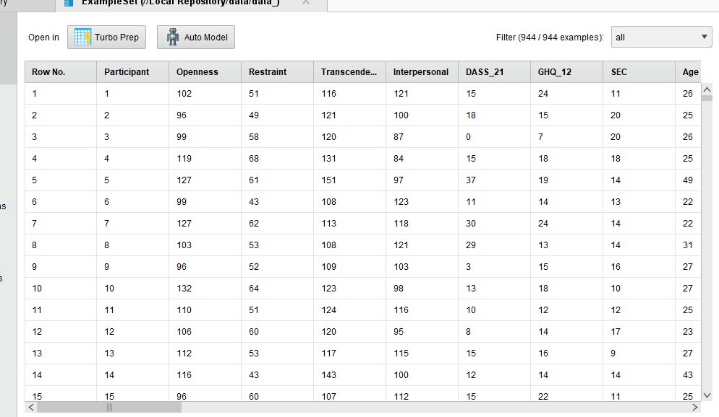

Slide 10

Steps of Methodology
Import Dataset
Data preprocessing
Attribute Selection
No missing value and outlier found
Apply model
DASS_depression, gender, age, hope, gratitude etc.
Result
Gradient Boosted Tree, Random Forest, Deep Learning Model
Accuracy
Error

Slide 11
Description of Statistics
According to statistics
Nearly 77.6% people’s anxiety is scaled between 0 to 5 and 16.4% people’s anxiety is scaled between 5 to 10 and 5% people’s anxiety is scaled between 10 to 17.5.
About 54% people’s depression is scaled between 0 to 5 and 30.8% people’s depression is scaled between 5 to 10 and 15% people’s depression is scaled between 10 to 22.5.
About 29.13% people’s stress is scaled between 0 to 5 and 46% people’s stress is scaled between 5 to 10 and 24.7% people’s stress is scaled between 10 to 22.5.

Slide 12
Description of Statistics (cont’d)
About 9% people are scaled between 0 to 10 and 77.7% are scaled between 10 to 20 and 13.3% people are scaled between 20 to 25 for self-efficacy for Covid-19 .

Slide 13
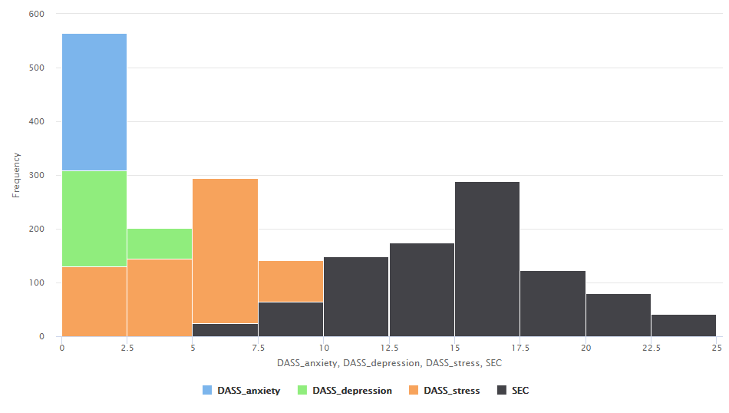
Statistics (cont’d)

Slide 14
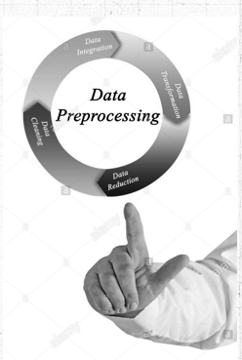
Data Preprocessing
Dataset was imported in Rapid Minor and explored through it.
No missing vales and outliers were found.

Slide 15
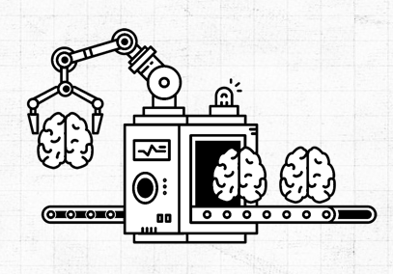
Model Applied
We have applied three different models
Gradient Boost Tree
Deep Learning
Random Forest model

Slide 16

Results
Techniques | Root Mean Squared-Error | Absolute Error | Relative Error | Squared Error
Gradient boosted tree | 3.789+/-0.000 | 2.957+/-2.369 | 22.08%+/-27.6% | 14.45+/21.422
Deep learning | 1.739+/-0.000 | 1.380+/-1.058 | 29.51%+/-41.3% | 3.025+/-4.299
Random forest | 3.560+/-0.000 | 2.710+/-2.309 | 20.35%+/-29.26 | 12.676+/-24.246

Slide 17


Conclusion
Random Forest, Gradient Boosted Tree and Deep Learning Models were applied on DASS_depression, DASS_anxiety, DASS_stress and self-efficacy of COVID-19, their results were compared and the deep learning model worked more efficiently.

Slide 18

Thank You

